Slide 1
機動學 Mechanisms Introduction to Matlab
國立台灣大學機械工程學系
授課教師: 蘇偉儁
Fall 2017
台大機械系 NTUME
Notes:
Chapter 8

Slide 2
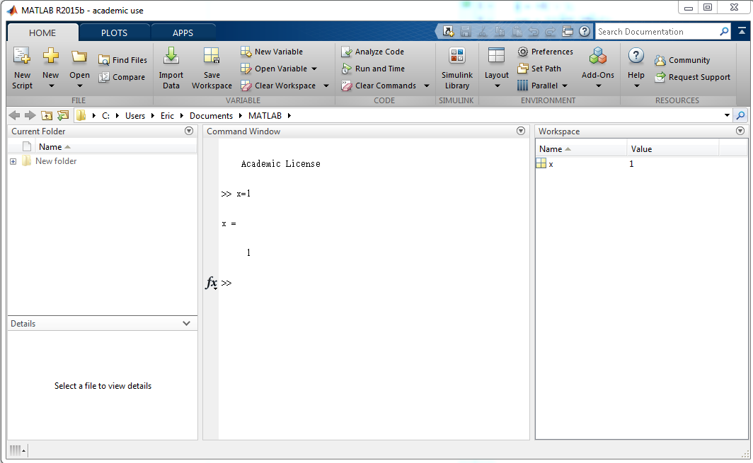
Interface
create new files
Workspace: where you can see the variables and their values
Command Window: where you can input your command and perform calculation

Slide 3
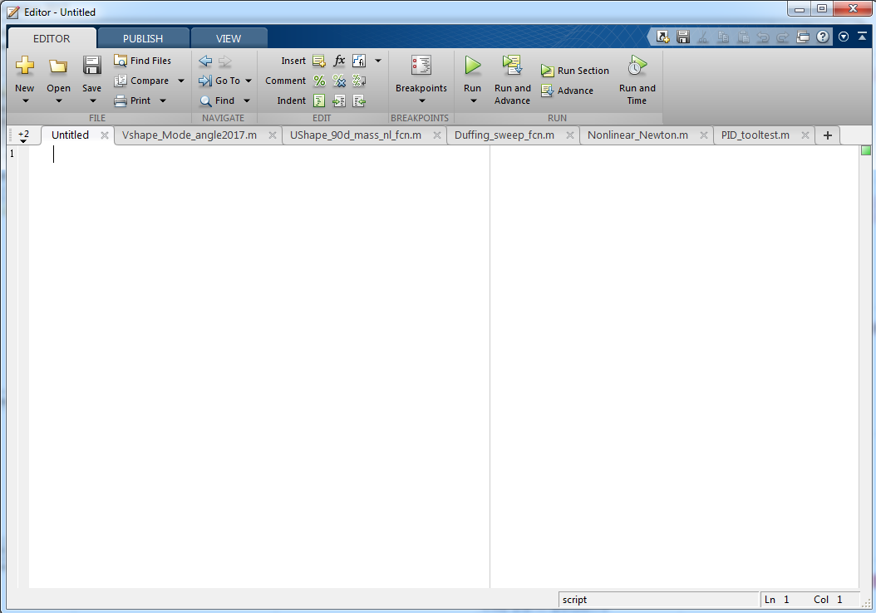
Editor
You can input multiple commands in a script and click run to run all the commands.
You can also edit function files in the editor.

Slide 4
Example: Plot two Curves
let’s plot y1 = 20cos(3x) & y2 = x³ + 2x² - 5x + 1, x from -5 to 5
Open the file “Matlab_Tutorial_Plot.m”
Note:
if there is a “%” in the beginning of a line, then the whole line is a comment, which means it is not functional. You can select the lines and then press ctrl + R to make them comments or press ctrl + U to remove the comments.
without a “;” in the end of a line, the variables/results will be displayed in the command window
put a “.” in front of the multiple/divide operators (including *, /, ^) for array/matrix calculation
what’s the difference between [1 2 3].*[1 2 3] & [1 2 3]*[1 2 3]’
Matlab_Tutorial_Plot.m

Slide 5
Commonly Used Commands
help function_name
doc function_name
clear all or clear variable
close
clc

Slide 6
Array & Matrix
if abc is an array with 10 elements, use abc(i) to access its i^{th} element
abc = [1 2 5 3 7 8 1 -5 7 9]; abc(7) = ??
if ABC is a 8 x 6 matrix, use ABC(i,j) to access the component (i^{th} row, j^{th} colume)
ABC = [3 2 1; 6 5 4; 9 8 7]; ABC(2,1) = ??
To transpose a matrix A, either A’ or transpose(A) works.
To find the inverse of a matrix, simply use inv(matrix_name)

Slide 7
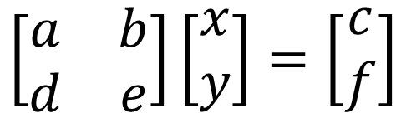
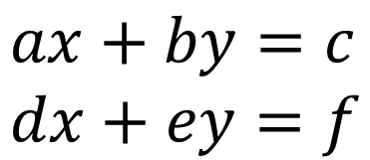



Matrix Calculation
Matlab is good at matrix calculation.
Linear equations can be written in the form of matrix.
e.g.
$$ax+by=c \\ dx+ey=f$$
$$\left[\begin{matrix}a & b \\ d & e\end{matrix}\right]\left[\begin{matrix}x \\ y\end{matrix}\right]=\left[\begin{matrix}c \\ f\end{matrix}\right]$$
$$slove for x \& y$$
$$A X = B$$
$$X =A^{−1}B$$

Slide 8

Exercise
Solve the linear equations
$$5x+3y+7z=−9 \\ −3x+9y+8z=17 \\ 2x−4y−3z=5$$
Exercise_Linear.m

Slide 9
Loops & IF
for {index} ... end
while {statement} ... end
if {statement} (else) ... end
break
end execution of the nearest enclosing loop

Slide 10
“=“ vs. “==“
what’s the difference between “i = 1” and “i == 1”
i = 1 : assign 1 to i
i == 1 : Boolean, check if i equals 1. If yes, return 1 (true); if no return 0 (false)
what’s the result of the following two cases
case 1: a = 1; a == 2 ans = ???
case 2: a = 1; a == 1 ans = ???

Slide 11
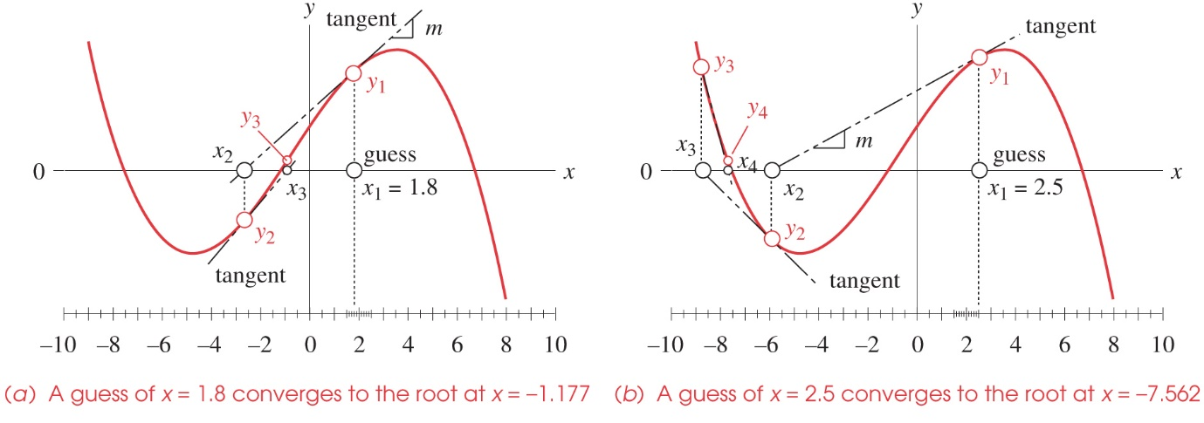
1D Nonlinear
Applying Newton-Raphson Method to solve 1-D nonlinear problems
Example: solve -x³-2x²+50x+60=0,
set y=-x³-2x²+50x+60, try different x until y→0
NewtonRaph1D.m

Slide 12
Exercise
Solve the nonlinear equation:
-x² + x∙sin(x) + x + 10 = 0
NewtonRaph1D_exercise.m

Slide 13
Fsolve
An alternative way to solve nonlinear equations is to use the matlab built-in function fsolve
type help fsolve to see how to use it
create a function for the equations so fsolve can call it
solve -x³-2x²+50x+60=0
solve a² + 2b + 1 = 0 & a – b³ -5 = 0
Fsolve_1D.m
Fsolve_1D_fcn.m
Fsolve_2D.m
Fsolve_2D_fcn.m

Slide 14
Function
function [ output_args ] = function_name( input_args )
end

